Slide 1
Claude Code for AI-assisted Software Development
Premalatha T

Slide 2

WHO AM I?
LinkedIn: https://www.linkedin.com/in/latha-t-k-b21018128/
Data Science ,AIML
Data Analysis ,SQL, PySpark
Data Visualization ,PowerBI, Tableau
Natural Language Processing (NLP)
Computer Vision
Generative AI, Prompt Engineering
BigData and Data Engineering

Slide 3
What is Artificial Intelligence?
Artificial Intelligence (AI) refers to the ability of machines or computer systems to perform tasks that normally require human intelligence.

Slide 4
Tasks
Learning from data
Understanding language
Recognizing images and speech
Making decisions
Solving problems
Generating content
Reasoning and planning

Slide 5
AI Around Us
Google Search
Maps Navigation
Netflix Recommendations
Amazon Product Suggestions
Face Unlock
Voice Assistants
Spam Detection
Grammar Correction
Banking Fraud Detection
Healthcare Diagnosis Support

Slide 6
How many AI applications have you already used before reaching office today

Slide 7
AI is Like a Student
Human Student
Learns from books
Makes mistakes
Improves through practice

Slide 8
AI is Like a Student
AI Model
Learns from data
Makes predictions
Improves with better training
Important Message
AI does not "think."
It predicts the most probable answer.

Slide 9
Activity
Create a realistic image of a software engineer working in an office.

Slide 10
Create an image of a man writing with Left hand

Slide 11
Image Generation
Create an image of a doctor treating a patient.
Then ask participants:
Now modify the prompt.
Examples
Female doctor
Rural hospital
Pediatrician
Wearing PPE
Elderly patient
Wheelchair user

Slide 12
According to our communication sofar,
Which hindi movie character do you relate me with? Justify.

Slide 13


Slide 14


Slide 15


Slide 16


Slide 17


Slide 18


Slide 19
Why AI Sometimes Fails
Bias
Hallucination
Outdated knowledge (depending on the model)
Lack of common sense
Ambiguous prompts
No emotions
Cannot verify every answer
Golden Rule
AI should assist human decision-making—not replace it.

Slide 20
Evolution of AI Systems
How AI Has Evolved
Artificial Intelligence has evolved from rule-based systems to autonomous AI agents capable of reasoning and taking actions.
AI Evolution Journey
Rule-Based Systems → Machine Learning → Deep Learning → Generative AI → Agentic AI
Key Message
AI has evolved from following instructions to learning, creating, and now acting autonomously.

Slide 21
Stage 1: Rule-Based AI (1950s–1990s)
AI Based on Rules
Early AI systems relied on predefined rules written by humans.
How It Works
Input → Rules → Output
Example:
If balance < ₹500 → Low balance alert

Slide 22
Stage 1: Rule-Based AI (1950s–1990s)
No learning
Deterministic
Easy to explain
Limited flexibility
Examples
Tax calculators
Early expert systems
Rule-based chatbots

Slide 23
Stage 2: Machine Learning
Example
Rather than coding every fraud rule:
Train a model on millions of transactions.
The model identifies suspicious patterns.
Applications
Spam detection
Credit scoring
Product recommendations
Customer churn prediction

Slide 24
Stage 3: Deep Learning
Learning Complex Patterns
Deep Learning uses artificial neural networks inspired by the human brain.
What Changed?
AI became much better at:
Image recognition
Speech recognition
Language understanding
Video analysis

Slide 25
Stage 3: Deep Learning
Examples
Face recognition
Self-driving perception
Medical image analysis
Voice assistants
Activity
Show an image and ask participants:
"Can AI identify whether this is a cat or a dog?"
Discuss how deep learning learns visual patterns instead of handcrafted rules.

Slide 26
Stage 4: Generative AI
AI That Creates
Generative AI doesn't just analyze data—it creates new content.
It Can Generate
Text
Images
Code
Audio
Video
Presentations

Slide 27
Stage 4: Generative AI
Examples
ChatGPT
Image generation tools
AI coding assistants
AI presentation tools

Slide 28
Stage 4: Generative AI
Prompt:
"Create a professional email requesting leave.“
Change the prompt:
"Make it formal."

Slide 29
Stage 5: Agentic AI
AI That Acts
Agentic AI moves beyond generating answers.
It can:
Plan
Reason
Use tools
Make decisions
Complete multi-step tasks
Monitor progress

Slide 30
Stage 5: Agentic AI
Organize next week's customer meeting."
The AI agent can:
Read emails
Find available meeting slots
Create an agenda
Generate presentation slides
Send calendar invitations

Slide 31
AI vs ML vs DL vs Generative AI
AI, Machine Learning, Deep Learning, and Generative AI are not competing technologies—they are nested technologies, where each builds upon the previous one.
Artificial Intelligence (AI)
│
├── Machine Learning (ML)
│ │
│ └── Deep Learning (DL)
│ │
│ └── Generative AI (GenAI)
Key Message
Every Generative AI model uses Deep Learning, every Deep Learning model is a Machine Learning model, and every Machine Learning model is part of Artificial Intelligence.

Slide 32
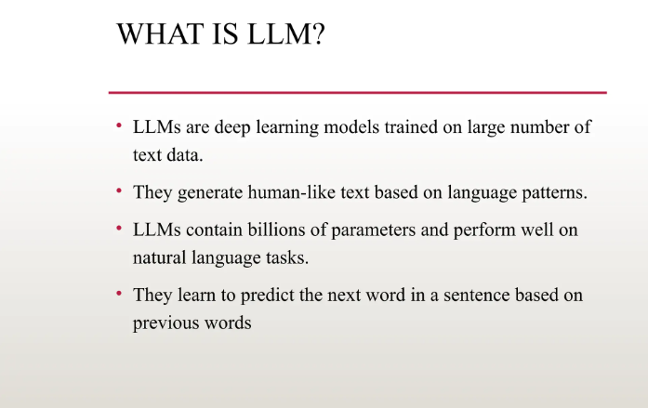

Slide 33
What is a Large Language Model (LLM)?
A Large Language Model (LLM) is an AI model trained on massive amounts of text to understand and generate human language.
What can an LLM do?
Answer questions
Summarize documents
Generate code
Translate languages
Draft emails
Analyze text
Create reports
Explain concepts

Slide 34
What is a Large Language Model (LLM)?
An LLM doesn't "know" facts like a human—it predicts the most likely next word (or token) based on patterns learned from vast amounts of text.

Slide 35
How Does an LLM Learn?
Learning from Massive Text Data
An LLM is trained on billions of words from books, articles, websites, code, and other text sources.
Learning Process
Training Data
↓
Learns Patterns
↓
Understands Context
↓
Predicts the Next Word

Slide 36
Tokens: How LLMs Read Text
LLMs Read Tokens, Not Sentences
A token is a small unit of text.
Examples:
Sentence:
AI is changing healthcare.
Possible tokens:
AI is changing health care

Slide 37
Why Tokens Matter
Context window limits
Cost (API pricing often depends on tokens)
Response length
Processing speed

Slide 38
How an LLM Generates Responses
User Prompt
↓
Break into Tokens
↓
Understand Context
↓
Predict Next Token
↓
Generate Response

Slide 39
What Makes Modern LLMs Powerful?
Modern LLMs can:
Understand natural language
Follow instructions
Maintain conversation context
Generate code
Summarize long documents
Extract information
Perform reasoning over provided information
Work across multiple languages

Slide 40
Business Applications
Customer support
Software development
HR
Legal document review
Finance
Healthcare documentation

Slide 41
Demonstration: One Model, Many Tasks
Summarization
Summarize this article in five bullet points.
Translation
Translate this paragraph into French.
Coding
Write a Python function to calculate BMI.
Email
Draft a professional customer apology email.

Slide 42
Why Do We Need Transformers?
Before Transformers
Older AI models processed text one word at a time.
Example
The animal didn't cross the street because it was tired.

Slide 43
Before Transformers
Question:
Who is "it"?
Street?
Animal?
Older models often struggled with long-range context.

Slide 44
After Transformers
Transformers look at all the words together.
They understand relationships between words.
Animal : This ability to understand context is what Transformers made possible.

Slide 45
What is a Transformer?
A Transformer is the deep learning architecture that powers modern Large Language Models like ChatGPT.
Instead of reading words one after another,
it examines the entire sentence simultaneously.
Imagine reading an email.
Do you understand one word at a time?
No.
You understand the entire paragraph together.
Transformers work similarly.

Slide 46
Transformers analyze
every word
↓
relationship
↓
context
↓
meaning

Slide 47
Tokenization
Step 1 – Break into Tokens
Step 2 – Convert Words into Numbers
Doctor -> [0.45, 0.89, 0.12...]
Patient -> [0.51, 0.82, 0.18...]
Words with similar meanings have similar numerical representations.

Slide 48
Embeddings
Which words are closer?
Doctor Hospital Banana
Everyone answers
Doctor & Hospital
Embedding captures semantic similarity.

Slide 49
Attention Mechanism (The Heart of Transformers)
The nurse thanked the doctor because she saved the patient.
Who saved the patient?
The model pays more attention to
Nurse Doctor saved patient
It determines that she most likely refers to the nurse based on the sentence structure.

Slide 50
Multi-Head Attention
Imagine five employees reviewing the same email.
One checks: Grammar
Second checks: Meaning
Third checks: Tone
Fourth checks: Facts
Fifth checks: Intent
Each notices something different.
Transformers do something similar using multiple attention heads, each focusing on different relationships within the sentence

Slide 51
How foundation models generate responses
A Foundation Model is a large AI model trained on vast amounts of data that can be adapted to perform many different tasks without being trained separately for each one.
GPT models
Llama
Gemini
Claude
Mistral

Slide 52
Privacy & Data Security
Never Share Sensitive Information
Avoid entering into public AI tools:
Customer data
Patient records
Source code
Financial reports
Passwords
Confidential business strategies
Personally Identifiable Information (PII)

Slide 53
Ethical Concerns
If an AI system rejects a loan application, who should be accountable?
AI?
Developer?
Organization?
Human reviewer?

Slide 54
Prompt Injection & Misinformation
AI Can Be Manipulated
Prompt injection attacks
Fake documents
Misleading instructions
Fabricated references
Social engineering

Slide 55
AI Must Be Powerful and Trustworthy
The goal is not just to build AI—but to build AI that people can trust.
Fair
Transparent
Secure
Reliable
Accountable
Privacy-preserving

Slide 56
What is Responsible AI?
Responsible AI is the practice of designing, developing, deploying, and using AI systems in a safe, ethical, and trustworthy manner.

Slide 57
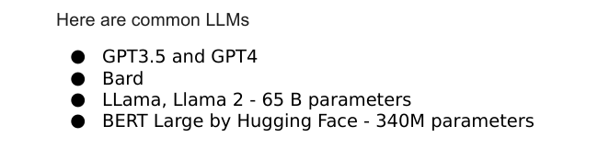

Slide 58
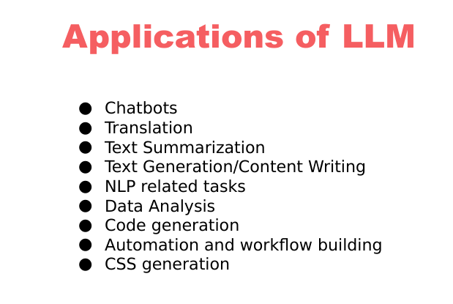

Slide 59
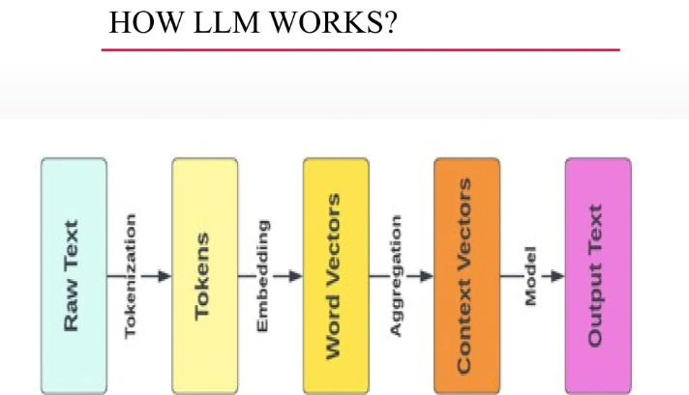

Slide 60
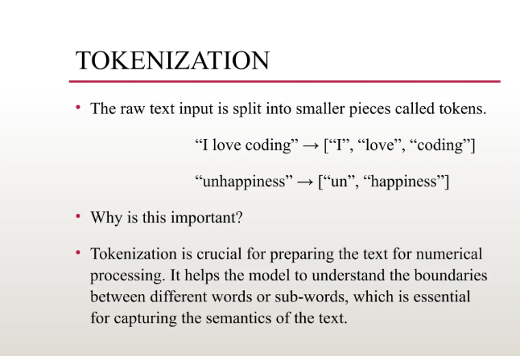

Slide 61
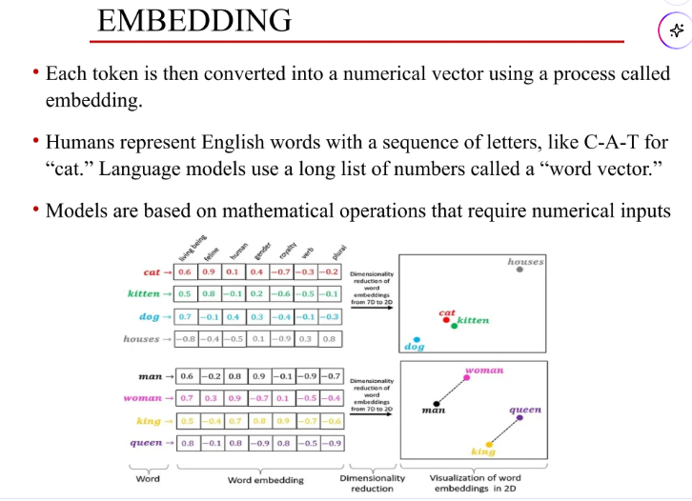

Slide 62
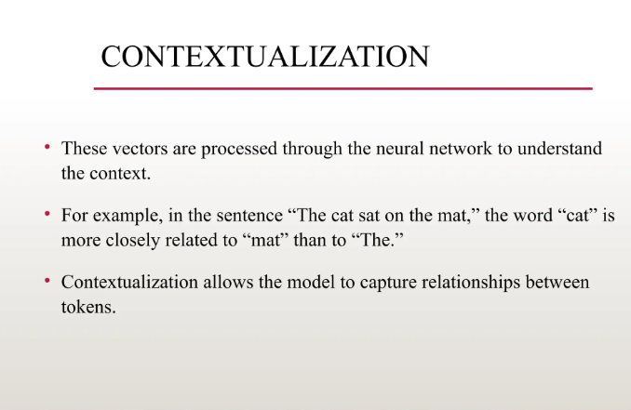

Slide 63
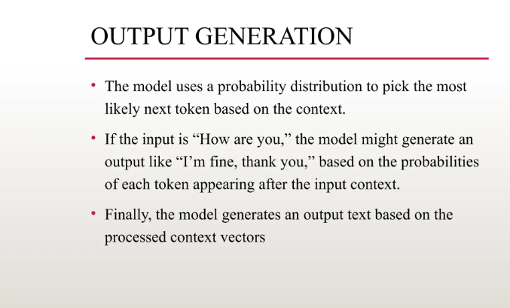

Slide 64
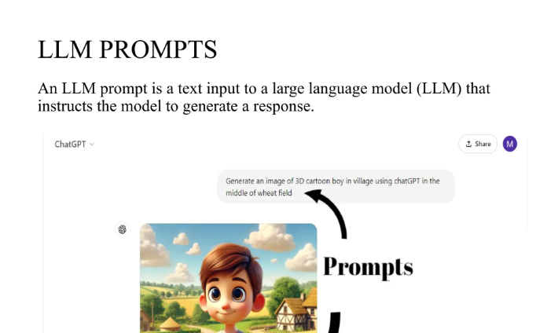

Slide 65
What is Prompt Engineering?
The practice of designing and refining prompts to optimize AI-generated responses.
Helps in guiding AI models like GPT-4 to produce relevant, accurate, and high-quality outputs.
Involves techniques like using clear instructions, providing context, and specifying output formats.
Used in applications such as chatbots, content generation, and decision-making systems.

Slide 66
Methods of Prompt Engineering
Zero-shot Prompting
Directly asking the model a question without examples.
Explain machine learning in simple terms.
What are the key factors affecting stock market prices?

Slide 67
Methods of Prompt Engineering
One-shot Prompting
Providing a single example to guide the AI’s response.
Example: “Translate ‘Hello’ to French: Bonjour. Now translate ‘Goodbye’.”

Slide 68
Methods of Prompt Engineering
One-shot Prompting:
If a person with a credit score of 750 and an income of $80,000 is approved for a loan, what about a person with a credit score of 680 and an income of $50,000?
Few-shot Prompting
A person with a credit score of 750 and income of $80,000 was approved.
A person with a credit score of 600 and income of $40,000 was denied.
A person with a credit score of 720 and income of $70,000 was approved.
Now, predict the loan decision for a person with a credit score of 680 and an income of $50,000."*

Slide 69
Methods of Prompt Engineering
Chain-of-Thought (CoT) Prompting
Encouraging step-by-step reasoning for complex problems.
Example: “Solve 24 × 3 + 12. First, multiply 24 by 3, then add 12.”
An investor is considering buying stocks in Company A. The company's revenue is growing at 10% per year, and it has a P/E ratio of 25. Interest rates are expected to rise next year. Should the investor buy the stock? Explain step by step.

Slide 70
Methods of Prompt Engineering
Role-based Prompting
Assigning a specific role to the AI for better responses.
Example: “You are a customer support agent. Answer the query professionally.”
You are a seasoned financial advisor. A client wants to invest ₹10 lakhs and is looking for low-risk options. Provide a step-by-step investment strategy.

Slide 71
Methods of Prompt Engineering
Persona-based Prompting
Making the AI respond in a particular style or tone.
Example: “Explain quantum physics as if you were a 5-year-old.”
You are the CFO of a multinational company. Your board is considering expanding into India. Analyze the financial risks and opportunities.

Slide 72
Methods of Prompt Engineering
Refinement and Iterative Prompting
Adjusting prompts based on initial responses for better results.
Example: If the response is too vague, rephrase with more details.

Slide 73
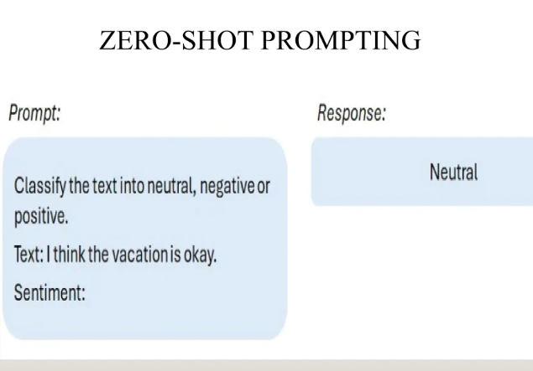

Slide 74
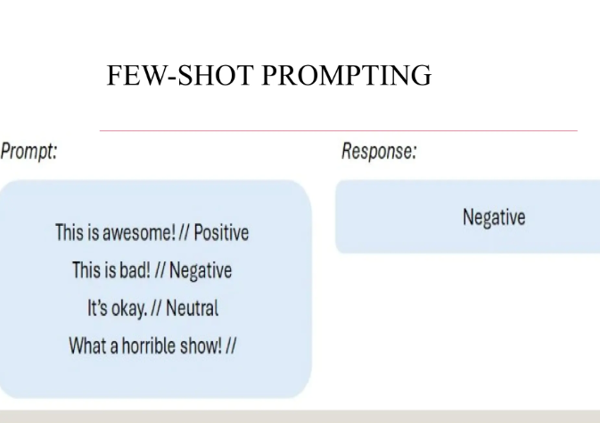

Slide 75
